Slide 1
GOOGLE TECHNOLOGIES FOR CLOUD AND WEB DEVELOPMENT 2016/2017
M veMate
Andrea Bagordo Davide Iannotta Edoardo Puglisi
Mentor: Matteo Anelli

Slide 2
How It Works
MoveMate helps you to share your daily trip to and from University with other students:
RideSharing for Car and Motorcycle IN the city (NOT ONLY between cities) with its advantages : save money offering a ride or joining one
Meet new friends by sharing the trip with public transports: create a team to «survive» the journey
Authentication via University credentials – «For students, By students»
Find the closest «Mate» and enjoy the trip!

Slide 3

First Milestone

Slide 4


Survey
Summary
Would you like to share your daily trip with someone?
How do you usually reach University ?
Got Wheels? Share a ride with someone
Public Transport or by feet?
Take a ride low-cost or..
Enjoy a walk with somebody else!

Slide 5
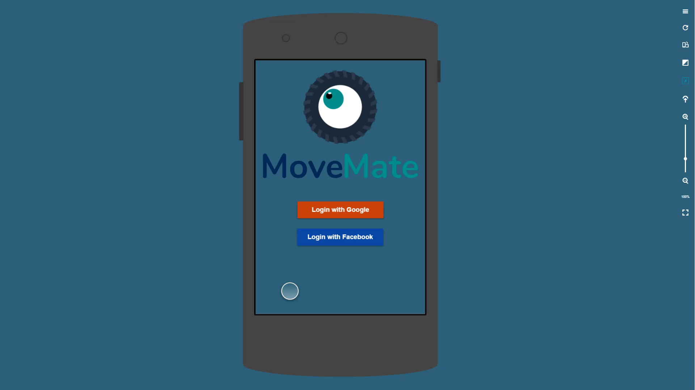
Mockup

Slide 6
Roadmap and expected features
Milestone 2:
Sql database implementation
Log-in system (G+, Facebook) and Authentication via university email address
Group Search & Creation
Milestone 3:
Google Maps integration
Feedback system
Application settings
Social sharing
Beta testing

Slide 7


Thank you!
unimovemate@gmail.com
https://github.com/movers-gcw/movemate

